Slide 1
Applying Game Theory to American Football
DEC
07
Stephanie, Eric, Rahul, Proby

Slide 2
01
INTRODUCTION
TABLE OF CONTENTS
02
SIMULTANEOUS GAME
03
SEQUENTIAL GAME
04
05
REAL WORLD vs. GAME THEORY
CONCLUSION

Slide 3
INTRODUCTION
What is the Fourth-and-Goal situation?
Occurs when the offense is close to scoring, demanding crucial strategic decisions
A test of strategic prowess for both offense and defense

Slide 4
VIEW AS A SIMULTANEOUS GAME
Nature of the Game
Game Dynamics
Focus on two options: offense choosing to run or pass, and defense choosing run defense, pass defense, or blitz.
Game simplified as a zero-sum game.
Defense’s utility is the inverse of the offense's.

Slide 5
SIMULTANEOUS GAME TABLE
 | RUN DEFENSE | PASS DEFENSE | BLITZ
RUN | -3,3 | 4,-4 | 6,-6
PASS | 9,-9 | -3,3 | -5,5
No absolute equilibrium found!

Slide 6
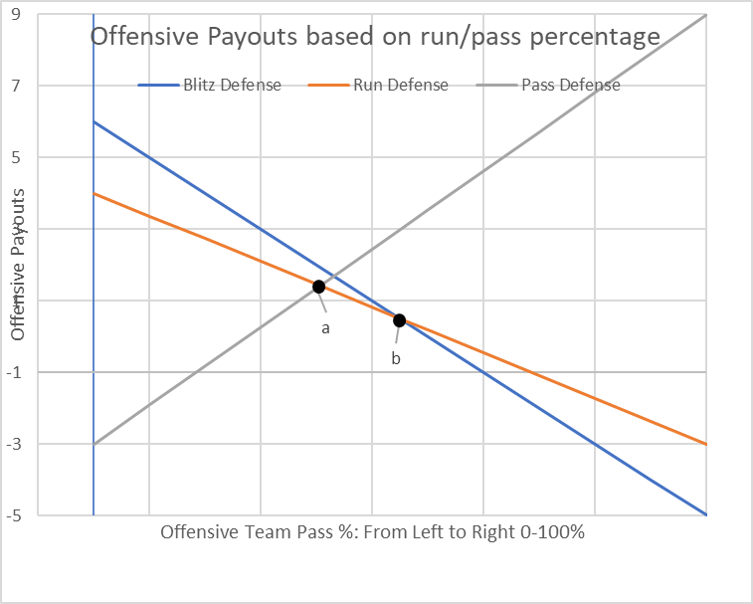

Slide 7
VIEW AS A SIMULTANEOUS GAME
Strategy and Optimal Game
Mixed strategies necessary due to the absence of a dominant strategy.
Optimal strategy identified: approximately 37% passing and 63% running.
Blitz strategy becomes more effective when passing exceeds 50%.

Slide 8
VIEW AS A SEQUENTIAL GAME
Nature of the Game
Game Dynamics
Assumption: No timeouts taken, simplifying the decision-making process
Offense acts first, followed by the defense's adjustment.
Focuses on how the defense adapts to the offense's formation and scheme.

Slide 9
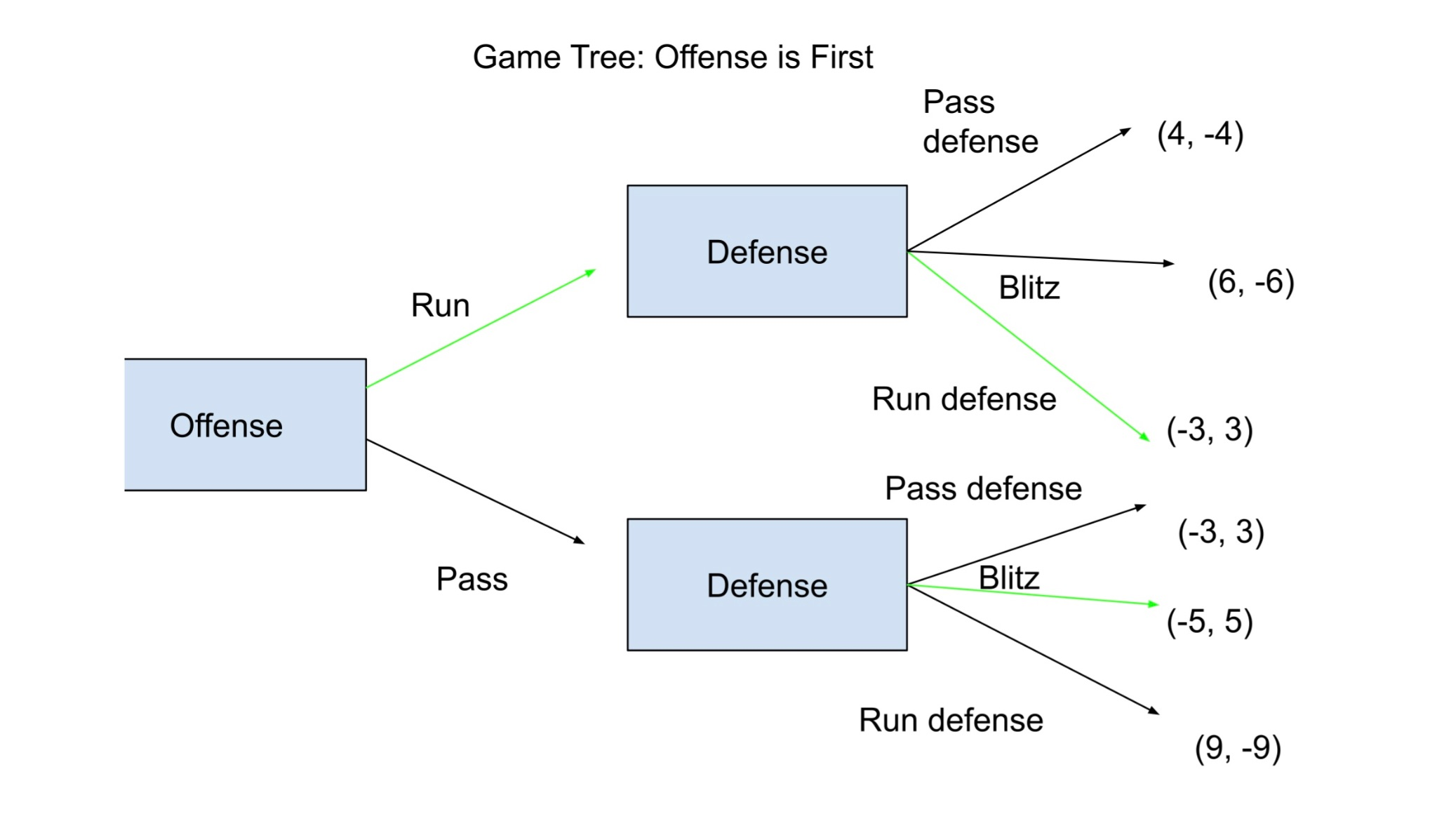
GAME TREE

Slide 10
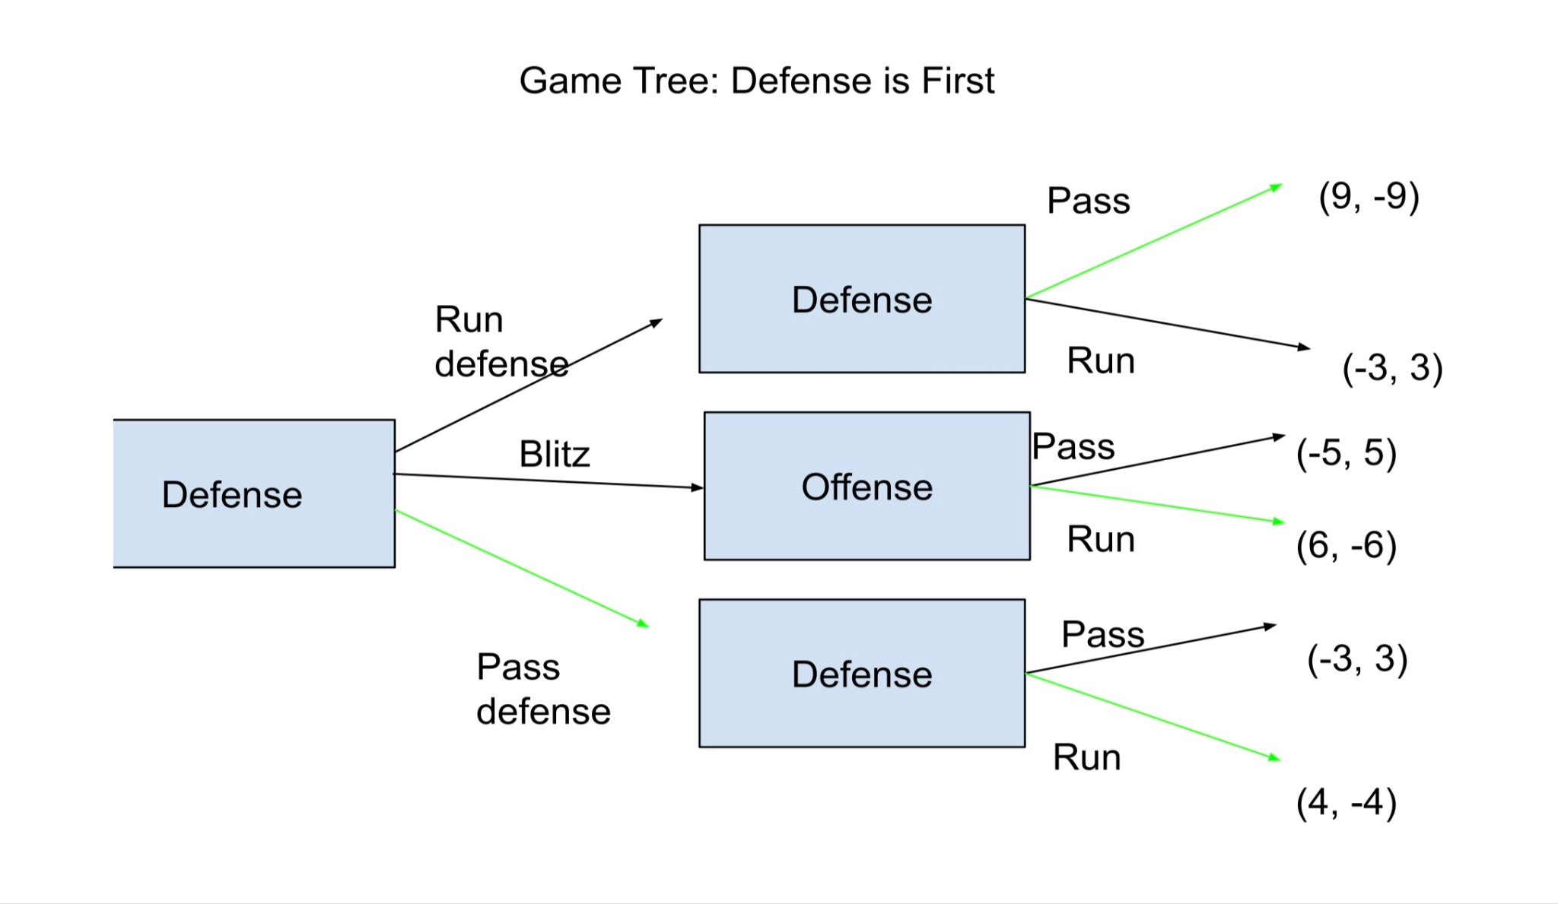
GAME TREE

Slide 11
VIEW AS A SEQUENTIAL GAME
Sequencing and Its Strategic Impact in Football
Second movers generally achieve more positive outcomes due to responsive advantages
The team that responds to the opponent's action gains an advantage
Ideal player profiles: Quarterbacks with high tactical intelligence, defensive players with strong offensive understanding.

Slide 12
REAL WORLD vs. GAME THEORY
Each Team is Materially Different
Personnel
  Important to consider both offense and defense
  Star players
  Historical Outcomes
  Injuries
Risk Tolerance
  Coaches Track Record
  Trust in Defense / Offense
Game Situation
  Field Position
  Clock Management
  Timeouts in Hand

Slide 13
CONCLUSION
Effective Game Theory Model
Role of Assumptions
Variability in Scenarios
Potential for Further Research

Slide 14
RESOURCES
https://www.nber.org/digest/oct09/game-theory-and-major-league-sports
https://www.nytimes.com/2014/09/05/upshot/4th-down-when-to-go-for-it-and-why.html

Slide 15
THANK YOU
Does anyone have any questions?

